Slide 1

South Texas Bobwhite Brigade
19th Battalion
Jane Doe

Slide 2

INDEX
REMINDER:
Put in chronological order & list activity type
Education
8.11.2016 - A3: Manned trifold display
8.31.2016 - A8: Attend a public hearing meeting
Research
8.22.2016 - B5: Volunteer with Texas Parks and Wildlife
Promotion
9.19.2016 - C8: Facebook
Creative Art
9.15.2016 - D3: Photography project
Other
NOTE:
Be creative using backgrounds, fonts, & borders around pictures.
This will not be viewed as a PowerPoint, so animations are unnecessary.

Slide 3
A. EDUCATION

Slide 4
CADET ACCOMPLISHMENTS
ACTIVITY REPORT FORM
Your Name: Jane Doe |  |  | Date of activity: 8/11/2016
Activity Category: A3 Manned trifold display |  |  | Location: Cabela's
Total Audience: 200+ |  |  | Time Spent on Activity: 2 hours
Group Addressed: Customers visiting Cabela's
Circle one: Bobwhite or Buckskin or Bass or Waterfowl or Ranch or Coastal
Brief summary of activity (topics covered, products produced, etc.):
I set up my trifold in the store and answered anyone’s questions about the
Texas Brigades and my display. I also handed out flyers & brochures with
my contact information to people interested in camp.
REMINDER:
Forms do not need to be signed
Verified by:
Johnny Begood |  | manager@cabelas.com
Name |  | E-mail
Manager |  | 555-555-5555
Title |  | Phone Number

Slide 5
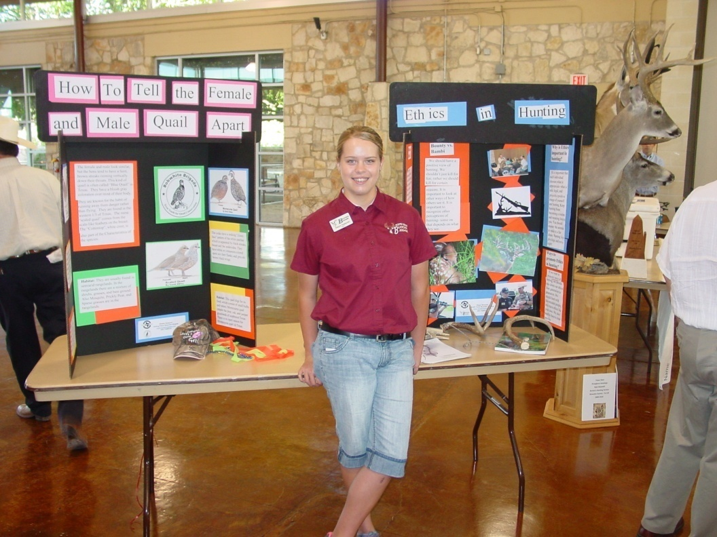
REMINDER:
Include pictures

Slide 6
CADET ACCOMPLISHMENTS
ACTIVITY REPORT FORM
Your Name: Jane Doe |  |  | Date of activity: 8/31/2016
Activity Category: A9 Speak at a public hearing or stakeholder’s meeting that concerns a conservation issue |  |  | Location: San Antonio
Total Audience: 100+ |  |  | Time Spent on Activity: 3 hours
Group Addressed: Hill Country Alliance and the general public
Circle one: Bobwhite or Buckskin or Bass or Waterfowl or Ranch or Coastal
Brief summary of activity (topics covered, products produced, etc.):
I submitted a testimony to the Texas Brigades and was chosen as one of three Cadets to speak to the Texas Parks and Wildlife Commissioners about my Texas Brigades experience. I thanked them for continuing to be a partner of Texas Brigades. This was my first major public speaking event and I now feel more confident to speak at additional venues.
Verified by:
Bob Citizen |  | mayor@townhall.com
Name |  | E-mail
Mayor |  | 555-555-5555
Title |  | Phone Number

Slide 7
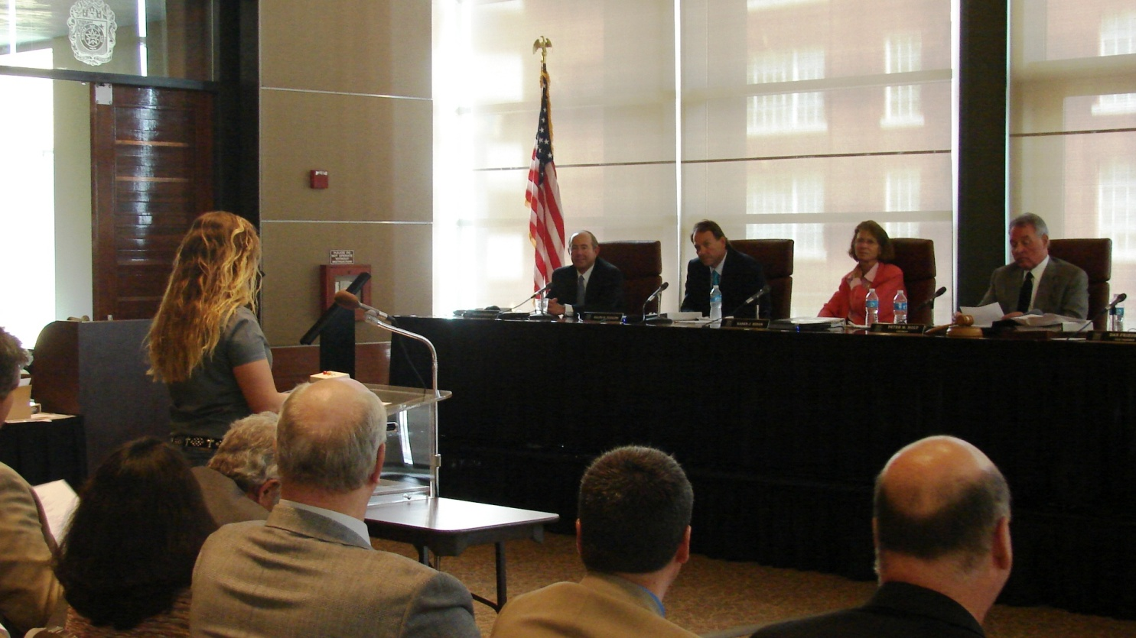

Slide 8
B. RESEARCH

Slide 9
CADET ACCOMPLISHMENTS
ACTIVITY REPORT FORM
Your Name: Jane Doe |  |  | Date of activity: 8/22/2016
Activity Category: B5 Volunteer with TPWD to conduct quail survey |  |  | Location: Buck Horn Creek Ranch, McCoy, TX
Total Audience: 6 |  |  | Time Spent on Activity: 3 hours
Group Addressed: biologists & the general public
Circle one: Bobwhite or Buckskin or Bass or Waterfowl or Ranch or Coastal
Brief summary of activity (topics covered, products produced, etc.):
Met with TPWD biologists to conduct a survey on the Buck Horn Creek Ranch. We searched & listened for bobwhite quail during their morning calling period.
The biologists concluded the bobwhite numbers were for fair for the time of year, etc… [Provide more info here]
Verified by:
First Last |  | first.last@tpwd.texas.gov
Name |  | E-mail
Biologist |  | 555-555-5555
Title Manager |  | Phone Number

Slide 10
TPWD SURVEY RESULTS
Number of bobwhite quail heard on the Buck Horn Creek Ranch on August 22, 2016.

Slide 11
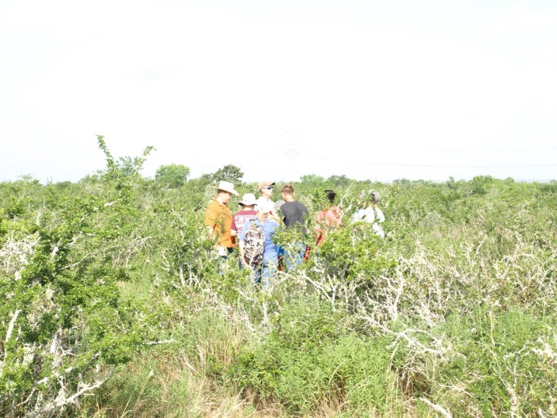
Survey at the Buck Horn Creek Ranch

Slide 12
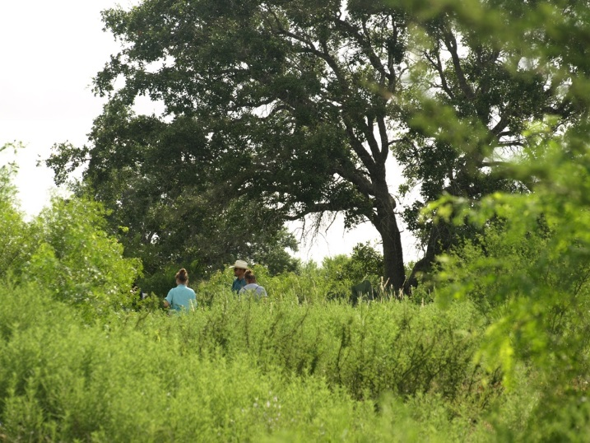
More Quail Survey

Slide 13
C. PROMOTION

Slide 14
CADET ACCOMPLISHMENTS
ACTIVITY REPORT FORM
Your Name: Jane Doe |  |  | Date of activity: 9/19/2016
Activity Category: C8 Facebook |  |  | Location: Home
Total Audience: Infinitely many |  |  | Time Spent on Activity: 1 minute
Group Addressed: personal friend & general public
Circle one: Bobwhite or Buckskin or Bass or Waterfowl or Ranch or Coastal
Brief summary of activity (topics covered, products produced, etc.):
After reading the article on the Rolling Plains Bobwhite Brigade, I determined it was an informative piece on the background of the program . I decided to “share” it with a friend who has shown interest in coming to camp to give her a brief history of what we’re about. I hope she will also “share” it her friends.
Verified by:
June Doe |  | junedoe@xyz.com
Name |  | E-mail
Mom |  | 555-555-5555
Title |  | Phone Number

Slide 15

Sharing Is Caring

Slide 16
D. CREATIVE ART

Slide 17
CADET ACCOMPLISHMENTS
ACTIVITY REPORT FORM
Your Name: Jane Doe |  |  | Date of activity: 9/15/2016
Activity Category: D3 Photography project |  |  | Location: New Braunfels, TX County Fairgrounds
Total Audience: 100+ |  |  | Time Spent on Activity: one week
Group Addressed: Visitors of the Comal County Fair
Circle one: Bobwhite or Buckskin or Bass or Waterfowl or Ranch or Coastal
Brief summary of activity (topics covered, products produced, etc.):
While in the field, collecting plants, I ran across this spider. After looking at the pictures I took, my mother suggested I enter one into a photo contest. There was an online entry form to register for the Comal County Fair Contest through the local feed store website. Results are pending and will be announced at the fair.
Verified by:
June Doe |  | junedoe@xyz.com
Name |  | E-mail
Mom |  | 555-555-5555
Title |  | Phone Number

Slide 18
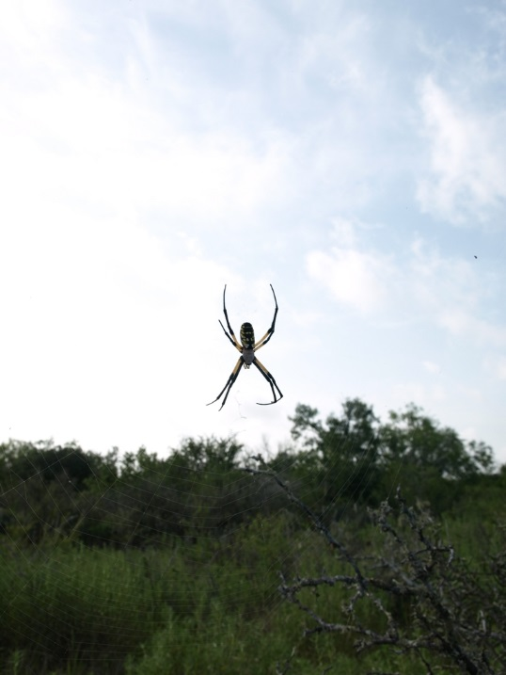
“Waiting Around”
REMINDER:
Pictures must be natural resource related

Slide 19
E. OTHER

